Slide 1

Software Development Processes
DevNet Training Series
Abhishek Pakrashi(apakrash)

Slide 2

Agenda
1
Introduction
2
Different Methodologies
3
Test-Drive Development
4
TDD Example
5
Git

Slide 3
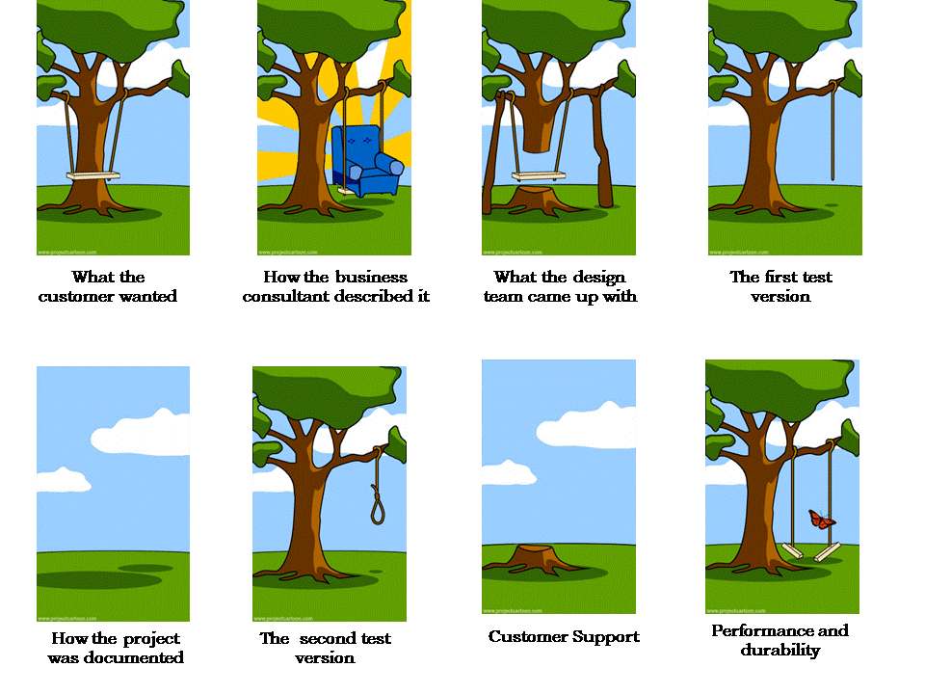
Why do we need processes

Slide 4
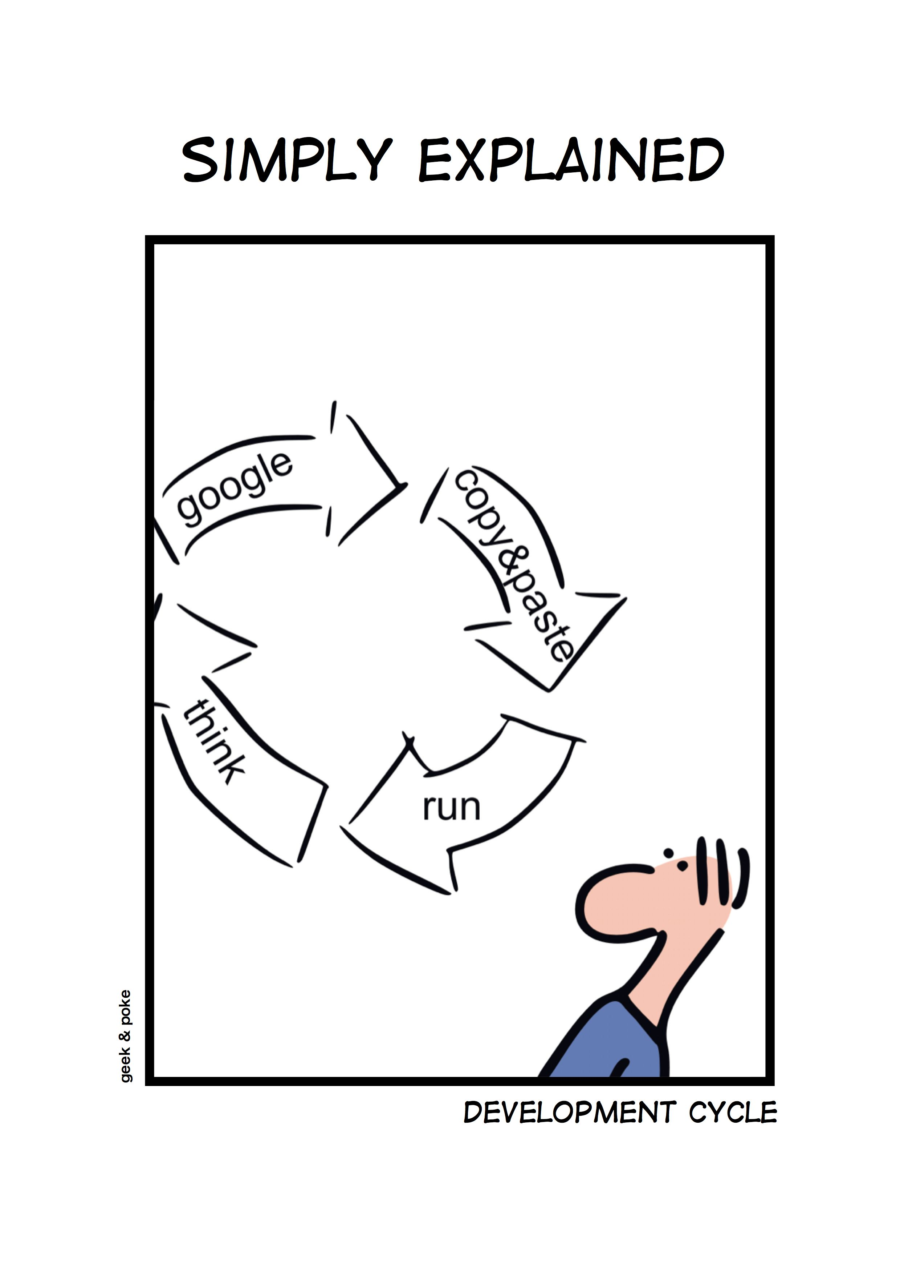
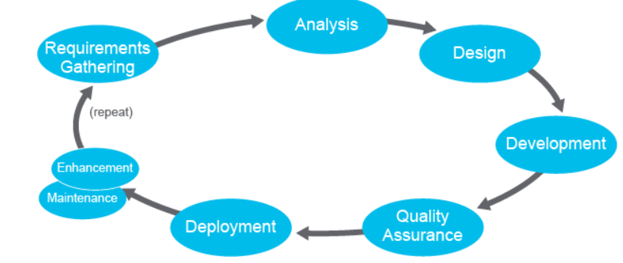
Imagining Development Methodology

Slide 5
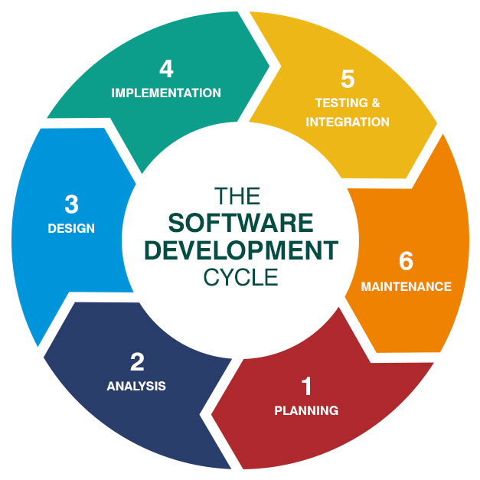
Software Development Methodologies

Slide 6
Types of Software LifeCycles
Waterfall
linear process
One phases at a time
Agile:
frequent
incremental releases.
Prototyping:
build an initial version quickly
Rapid app development:
less emphasis on planning more emphasis on process. incremental model
all components are developed in parallel.
Extreme programming: extension of Agile,
with unit testing, code reviews,
Source :https://ondemandelearning.cisco.com/cisco-ems/devasc10/sections/2/pages/2

Slide 7

Look at each slide, there will one or more mistakes hidden in then.
Guess which lifecycle is being talked about
Find the mistake
Disclaimer: there can be genuine mistakes too. At the time of presentation, if I say that that the certain mistake is done knowingly, don't believe :)

Slide 8
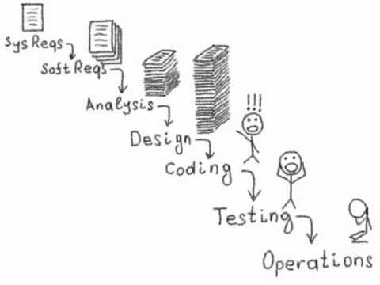
All Steps are sequential
One Step must be completed before going to the next
Customer gets the product during testing and maintenance
If there are new requirements, the whole process has to be repeated
This helps with rapid prototyping

Slide 9
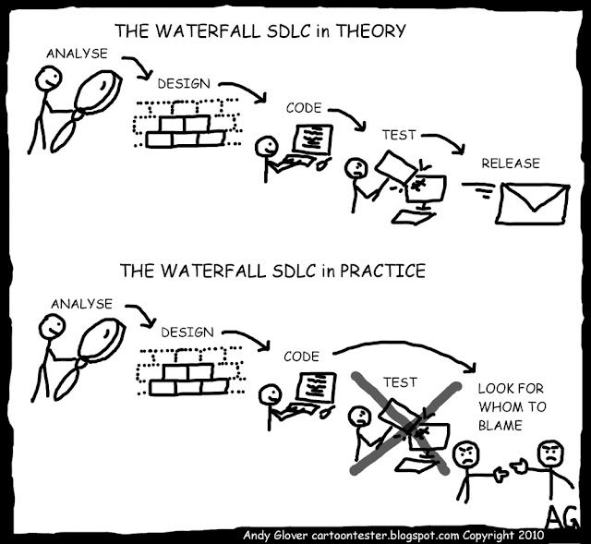
Waterfall Model
Advantage:
small well defined projects
easy metric management
Disadvantages
Not very practical for large project

Slide 10
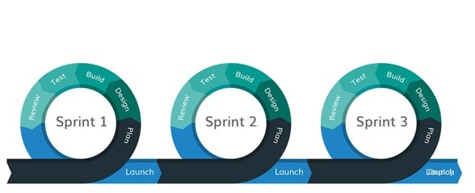
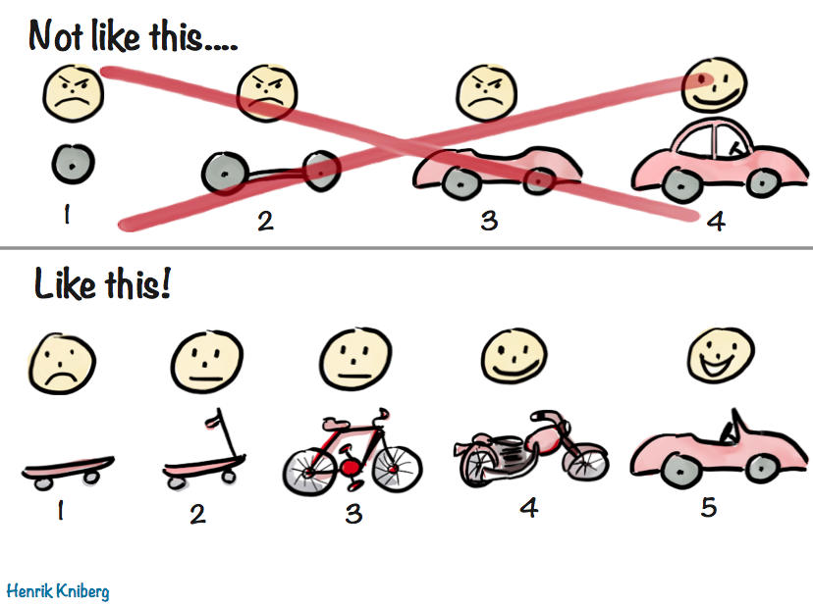
Work in iterations > Create shippable product at every milestone
Daily Scrum:
Daily plan
Challenge
Easy metric tracking

Slide 11
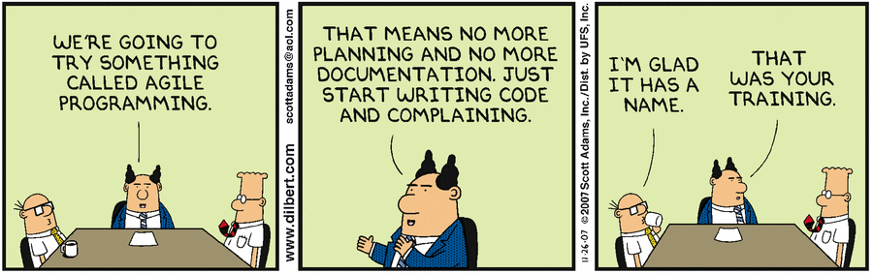
Agile Model
Advantage:
Works good for real life scenario
Works good for distributed teams,
The dev team can move to the next sprint, if the testing is taking longer
Product Changes can be made very late in the development lifecycle
Disadvantage
Bad for smaller projects with lesser people
Bad for documentation
Difficult metric tracking

Slide 12
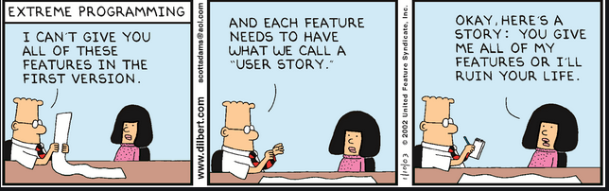
Prototyping: Prototype focused agile
Rapid app development: More planning and more emphasis on process. It is a type of incremental model in which all components are developed in parallel.
Extreme programming: More aggressive form of agile
Note: self reading topics

Slide 13
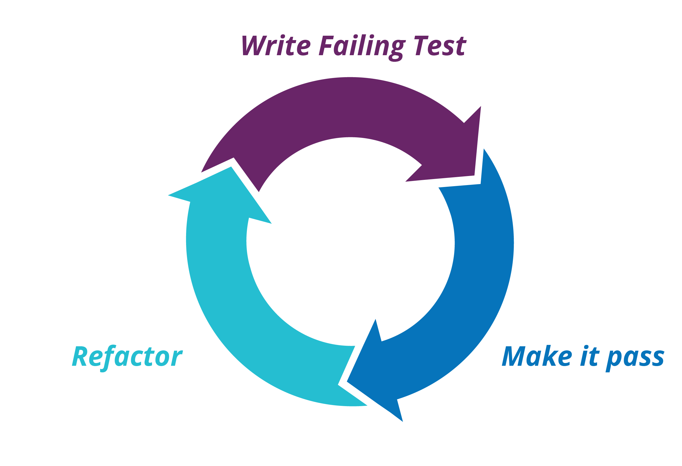
Test Driven Development

Slide 14
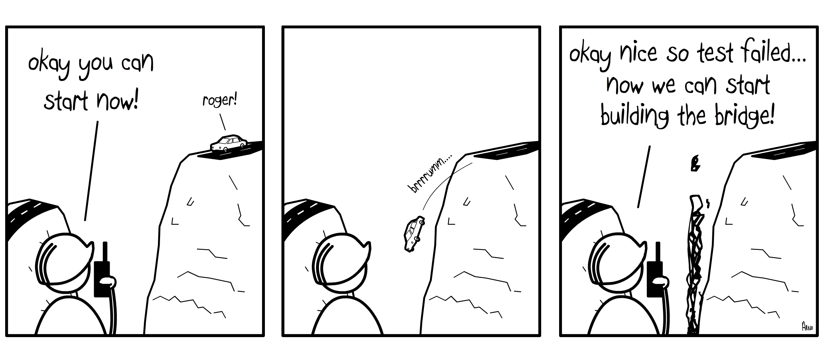
Write tests, make them very granular,
i.e. one assertion per test:
Input Validation
Output Validation
Correct Output
Edge cases
Efficiency
Run these tests; many may fail
Write source code, just to pass test
Run tests
Refactor the code where necessary.
Repeat
From <https://ondemandelearning.cisco.com/cisco-ems/devasc10/sections/2/pages/3>

Slide 15
Example of Test Driven Development
From top output in linux, find if the CPU has shot up more than 70%

Slide 16
Another Example
Leetcode example.
Let's try a case where edge cases checking is important.
Given an array of integers, return indices of the two numbers such that they add up to a specific target.
You may assume that each input would have exactly one solution, and you may not use the same element twice.
Example:
Given nums = [2, 7, 11, 15], target = 18,
Because nums[1] + nums[2] = 7 + 11 = 18,
return [1, 2].

Slide 17


Slide 18


Version Control
If unmanaged
=
Multiple software engineers

Slide 19

Need for discipline

Slide 20


Git and family
Others: CVS, SVN, Bazaar

Slide 21
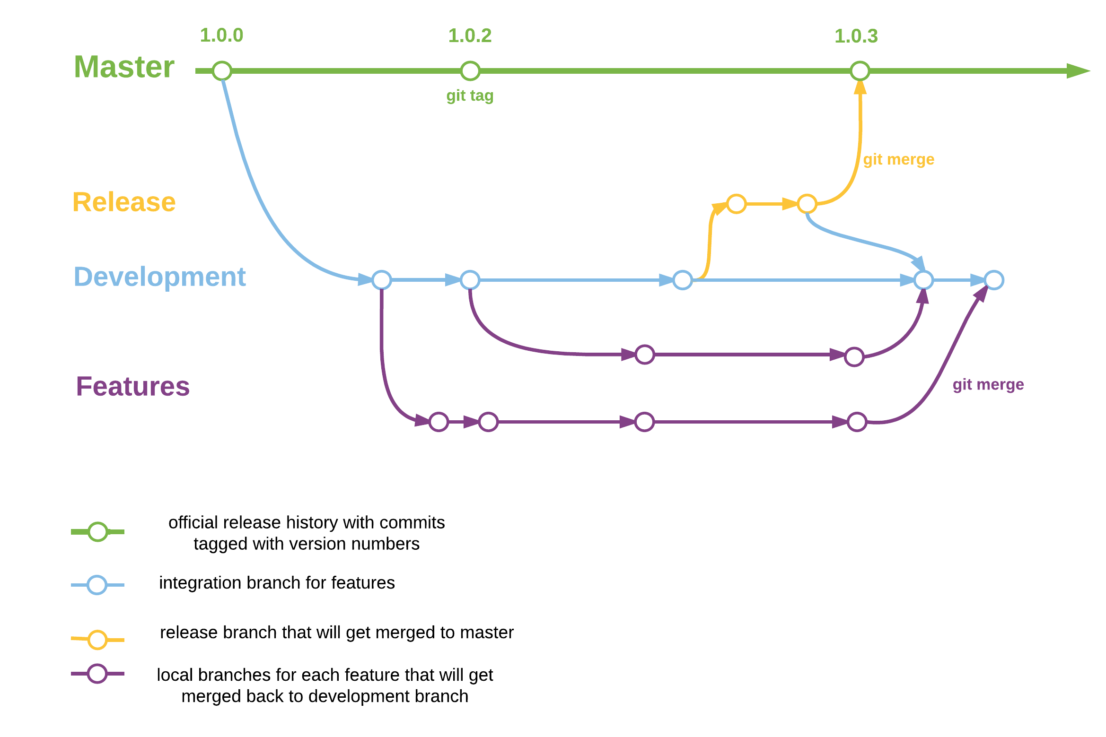
Git Features

Slide 22
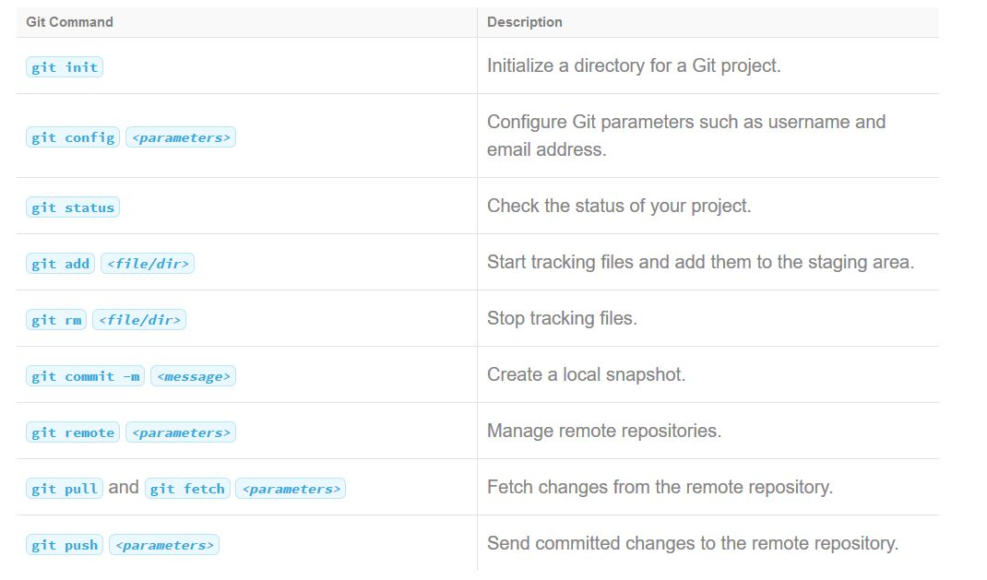
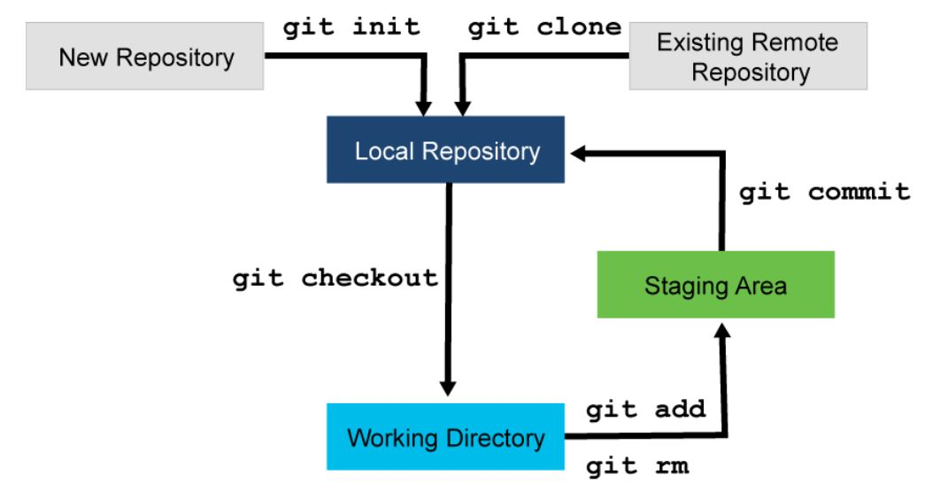
Git Theory continues

Slide 23
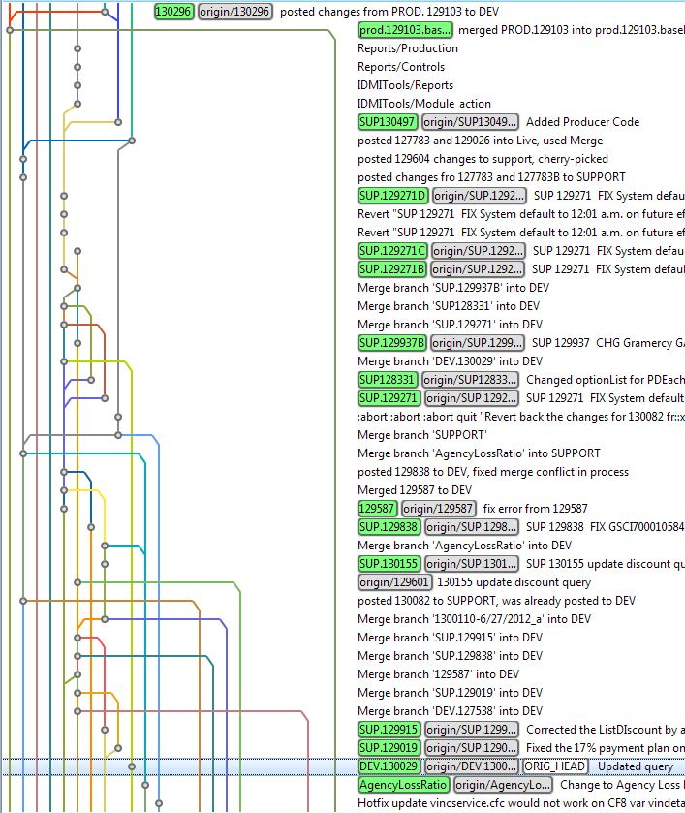

Git Theory vs Practical

Slide 24

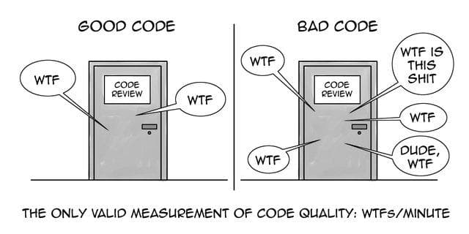
Code Review
Identify bugs
Code quality
*Read WTF=What the Fork
For compliance purposes

Slide 25
Methodology
New Branch
Create a Merge Request
Review
Merge

Slide 26
Git Examples and Best Practices

Slide 27


Thanks!
It’s time for Netflix now
</eof>

